Slide 1
PRoject Dental clinic database
Educational practice
Student: Kolomeyets Illarion
Teacher: Aidana Kalakova

Slide 2
Introduction
Nowadays, a lot of clinics are suffering due to the lack of an automated system for filling out forms, documents. Viewing this fact, I made this project.

Slide 3
Methadology
For the project I've used postgresql as a main tool to create a database management system. Also I've used google stuff to create erd diagram.

Slide 4

purpose
Project was aimed on creating useful database, which can be used to automize the work of a dent clinic.

Slide 5
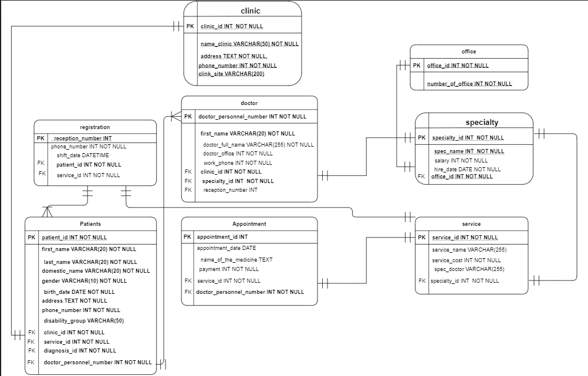
ERD diagram and atributes

Slide 6

The next slide will be gantt chart

Slide 7
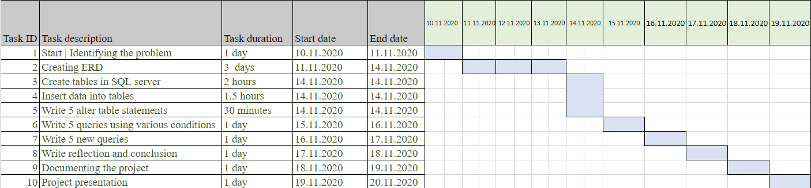

Slide 8
creating tables

Slide 9

Creating database
Here is some of the tables, I've created

Slide 10
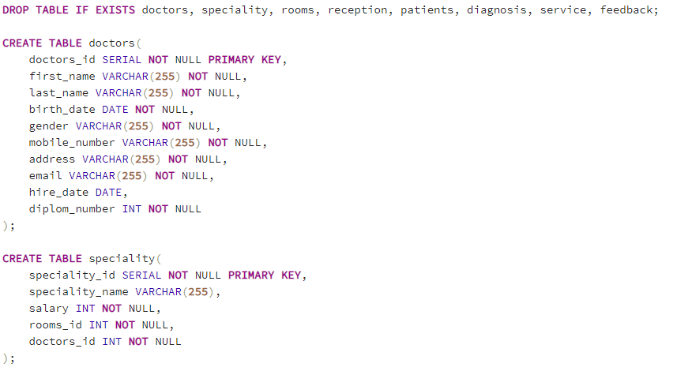

Slide 11
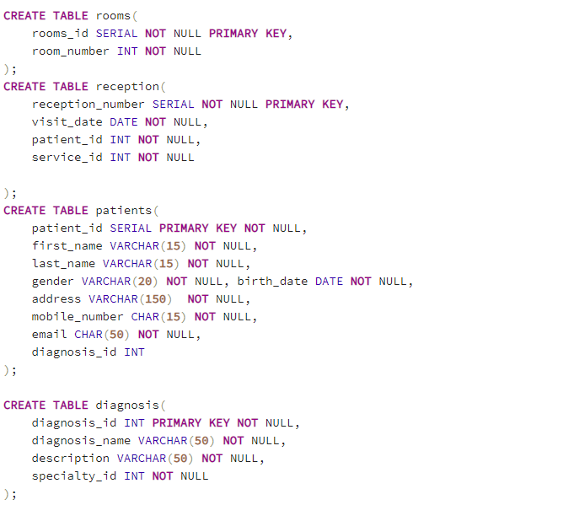

Slide 12
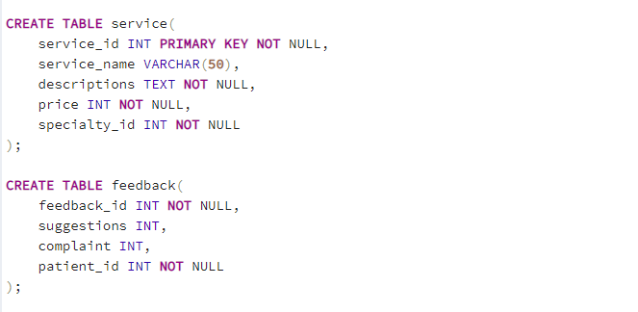

Slide 13
Here is the data, I've inserted in those tables.

Slide 14
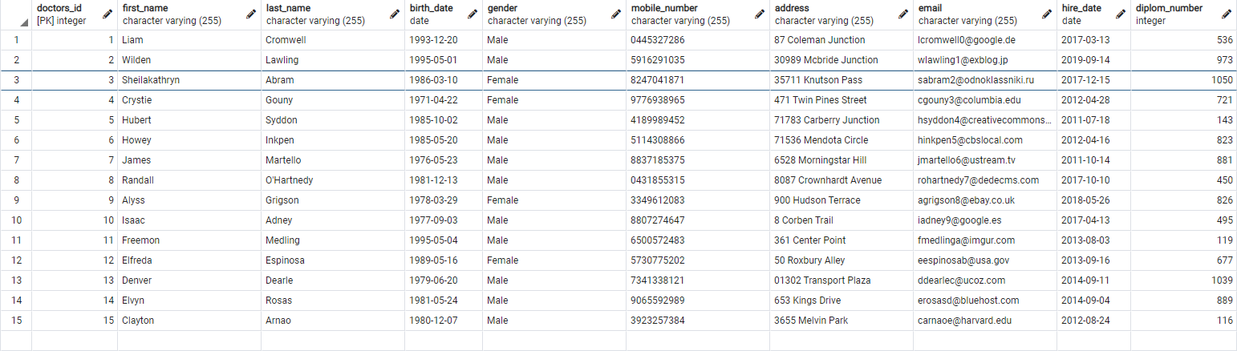

Slide 15
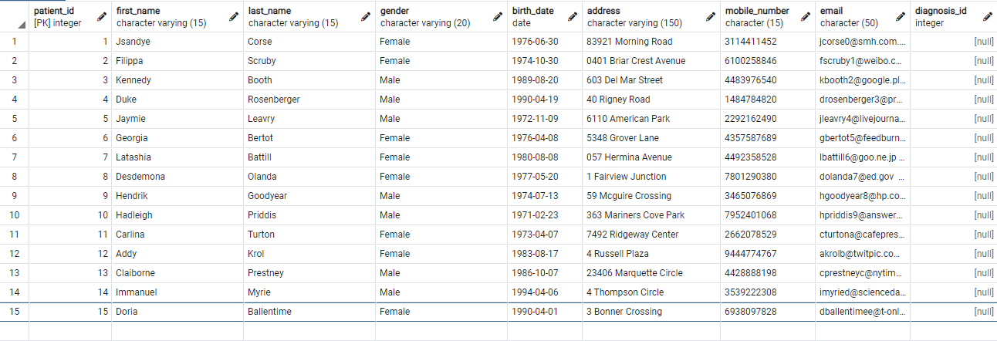

Slide 16

Here is the constraints, I've done

Slide 17
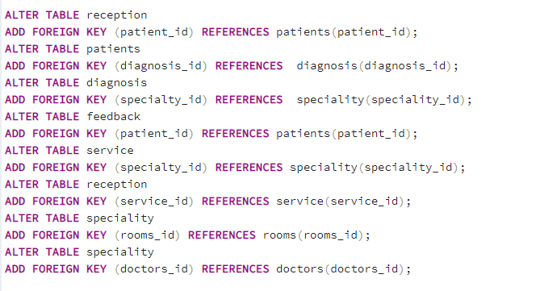

Slide 18
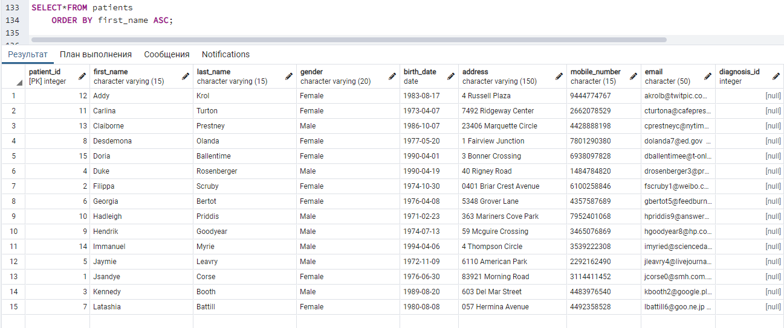
HEre some quiries I've written

Slide 19
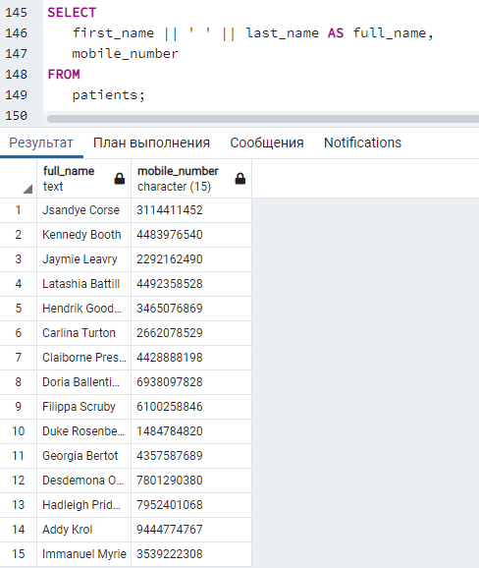

Slide 20
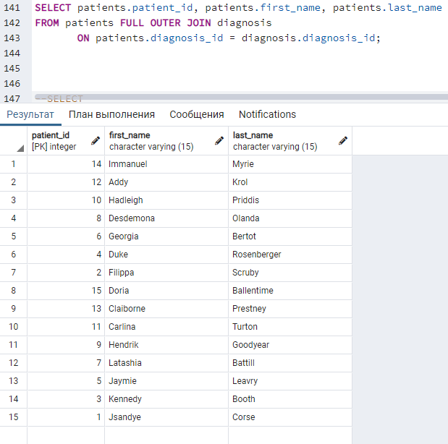

Slide 21
References:
https://en.wikipedia.org/wiki/Dentistry
https://www.journals.elsevier.com/dental-clinics-of-north-america/recent-articles
https://www.ncbi.nlm.nih.gov/pmc/articles/PMC3950740/

Slide 22


